Slide 1

VMware to Red Hat OpenShift Virtualization Migration Analysis & Proposed Solution for a Large European Bank
Team1

Slide 2
Agenda
Introduction
Timeline
Areas of growth
Summary
Primary goals
Presentation Title

Slide 3
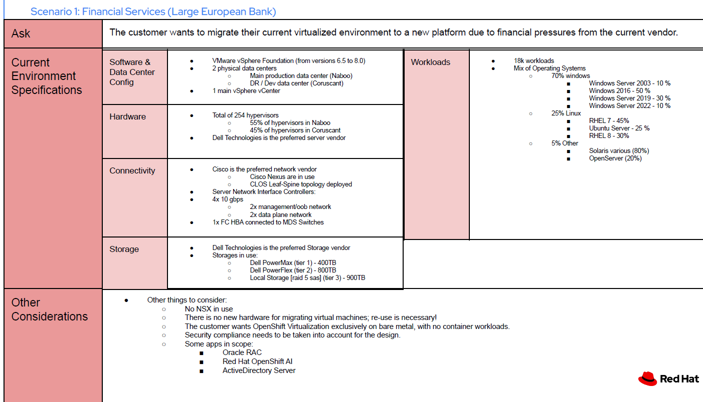

Slide 4
Executive Summary
The Challenge: A large European bank faces financial pressure from its current virtualization vendor, leading it to seek a new platform. The bank's environment consists of over 18,000 workloads on VMware Cloud Foundation, distributed across two physical data centers. A key requirement is to reuse existing hardware, with a focus on cost reduction and operational efficiency.
The Solution: Red Hat proposes a phased migration to OpenShift Virtualization, designed to transition approximately 16,500 in-scope VMs. This approach leverages the bank's existing Cisco and Dell hardware, modernizes key workloads (e.g., Datagrid, MongoDB, NodeJS) through containerization, and provides a clear path to enhanced operational consistency and security.
Key Highlights:
Phased Migration: A three-year plan using a "Migration Factory" model to ensure a smooth transition.
Cost Optimization: Significant savings through the elimination of legacy vendor licensing and the consolidation of VMs and containers on a single platform.
Enhanced Security: Recommendations for advanced microsegmentation to meet the bank's security posture requirements.

Slide 5
Current Environment Analysis
Total Workloads: ~18,000
workloadsOperating Systems:
70% Windows: Windows 2016 (50%), Windows 2019 (30%), Windows 2022 (10%).
25% Linux: RHEL 7 (45%), Ubuntu Server (25%), RHEL 8 (20%).5%
Other: Solaris various (80%), OpenServer (20%).
Categorization:
In-Scope Workloads: ~16,500 VMs for migration.
Out-of-Scope Workloads: ~1,500 VMs due to unsupported or end-of-life operating systems.
Infrastructure:
Data Centers: 2 physical data centers (Naboo and Coruscant) with a DR site.
Hypervisors: 254 total hypervisors (55% on Naboo, 45% on Coruscant)
Hardware:
Servers: Dell Technologies is the preferred server vendor.
Networking: Cisco Nexus with a CLOS leaf-spine topology.
Storage: Dell PowerMax, PowerFlex, and Local Storage.

Slide 6
Target Architecture
Migration Approach
Unified Platform
Reuse Existing Infrastructure
High Availability
Phased Strategy
Migration Velocity
Workload Prioritization
OpenShift Virtualization will serve as the single, unified platform for both virtualized workloads and native containers. This consolidates management and optimizes resource utilization.
The solution is designed to leverage the bank's existing physical servers, networking, and storage, eliminating the need for new hardware procurement.
The architecture will be laid out with multiple failure domains and OpenShift clusters to ensure no single point of failure (SPOF) for critical workloads.
Foundation Phase: Focus on building a "Migration Factory" for automation, testing, and developing migration plans. Accelerated
Migration Phase: Scale out the migration efforts, leveraging the automated processes to transition VMs in a rapid, repeatable manner.
The plan assumes a migration rate of approximately 20 VMs per day during the accelerated phase, with a total project duration of 3 years.
Workloads will be assessed for complexity, with easy and medium migrations prioritized in the initial waves.

Slide 7
Target Architecture
Migration Approach
Unified Platform
Reuse Existing Infrastructure
High Availability
Phased Strategy
Migration Velocity
Workload Prioritization
OpenShift Virtualization will serve as the single, unified platform for both virtualized workloads and native containers. This consolidates management and optimizes resource utilization.
The solution is designed to leverage the bank's existing physical servers, networking, and storage, eliminating the need for new hardware procurement.
The architecture will be laid out with multiple failure domains and OpenShift clusters to ensure no single point of failure (SPOF) for critical workloads.
Foundation Phase: Focus on building a "Migration Factory" for automation, testing, and developing migration plans. Accelerated
Migration Phase: Scale out the migration efforts, leveraging the automated processes to transition VMs in a rapid, repeatable manner.
The plan assumes a migration rate of approximately 20 VMs per day during the accelerated phase, with a total project duration of 3 years.
Workloads will be assessed for complexity, with easy and medium migrations prioritized in the initial waves.

Slide 8


Primary goals
ANNUAL REVENUE GROWTH

Slide 9
Quarterly performance

Slide 10
Areas of growth
Time period | B2B | Supply chain | ROI | E-commerce
Q1 | 4.5 | 2.3 | 1.7 | 5.0
Q2 | 3.2 | 5.1 | 4.4 | 3.0
Q3 | 2.1 | 1.7 | 2.5 | 2.8
Q4 | 4.5 | 2.2 | 1.7 | 70

Slide 11
“Business opportunities are like buses. There’s always another one coming.”
Richard Branson

Slide 12




Meet our team
Mirjam Nilsson
Rajesh Santoshi
Chief Executive Officer
VP Marketing
Takuma Hayashi
Flora Berggren
President
Chief Operations Officer

Slide 13








Meet our extended team
Takuma Hayashi
Graham Barnes
President
VP Product
Mirjam Nilsson
Rowan Murphy
Chief Executive Officer
SEO Strategist
Flora Berggren
Elizabeth Moore
Chief Operations Officer
Product Designer
Rajesh Santoshi
Robin Kline
VP Marketing
Content Developer

Slide 14





Plan for product launch
Planning
Marketing
Design
Strategy
Launch
Synergize scalable e-commerce
Disseminate standardized
metrics
Coordinate
e-business applications
Foster holistically superior methodologies
Deploy strategic networks with compelling
e-business needs

Slide 15
Plan for product launch
Planning
Marketing
Design
Strategy
Launch
Synergize scalable
e-commerce
Disseminate standardized metrics
Coordinate
e-business applications
Foster holistically superior methodologies
Deploy strategic networks with compelling
e-business needs

Slide 16
Timeline
Nov 20XX
May 20XX
Disseminate standardized metrics
Deploy strategy networks with compelling e-business needs
Sep 20XX
Synergize scalable
e-commerce
Jan 20XX
Mar 20XX
Coordinate e-business applications
Foster holistically superior methodologies

Slide 17

Areas of focus
B2B market scenarios
Cloud-based opportunities
Develop winning strategies to keep ahead of the competition
Capitalize on low-hanging fruit to identify a ballpark value
Visualize customer directed convergence
Iterative approaches to corporate strategy
Establish a management framework from the inside

Slide 18



How we get there
ROI
Envision multimedia-based expertise and cross-media growth strategies
Visualize quality intellectual capital
Engage worldwide methodologies with web-enabled technologies
Niche markets
Pursue scalable customer service through sustainable strategies
Engage top-line web services with cutting-edge deliverables
Supply chains
Cultivate one-to-one customer service with robust ideas
Maximize timely deliverables for real-time schemas

Slide 19


Summary
At Contoso, we believe in giving 110%. By using our next-generation data architecture, we help organizations virtually manage agile workflows. We thrive because of our market knowledge and great team behind our product. As our CEO says, “Efficiencies will come from proactively transforming how we do business.”

Slide 20




Thank you
Mirjam Nilsson
mirjam@contoso.com
www.contoso.com

